Slide 1
Security Testing

Slide 2
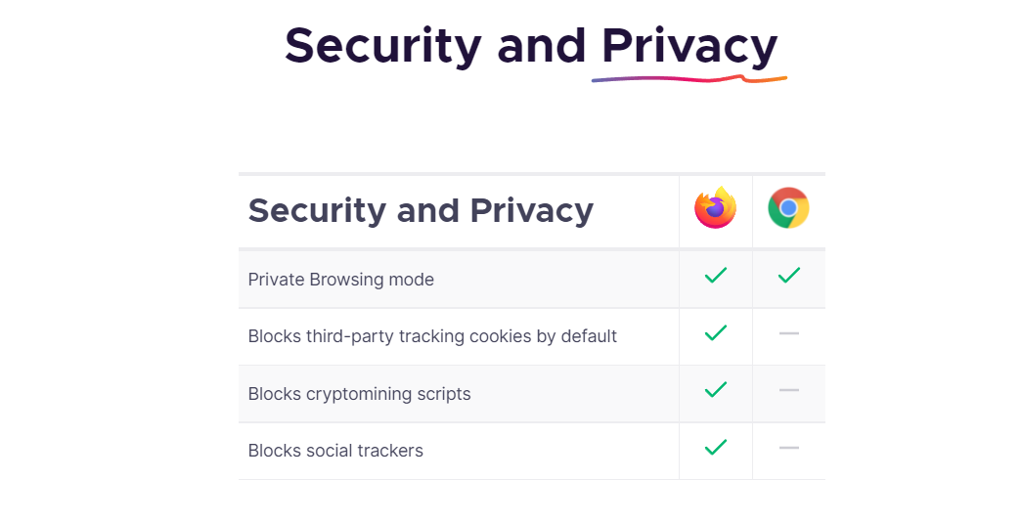
Security of Browsers

Slide 3
Proxy Server
A proxy server is a system or router that provides a gateway between users and the internet. Therefore, it helps prevent cyber attackers from entering a private network. It is a server, referred to as an “intermediary” because it goes between end-users and the web pages they visit online.

Slide 4
127.0.0.1 IP Address
The IP address 127.0.0.1 is a special-purpose IPv4 address and is called the Localhost or loopback address. All computers use this address as their own, but it doesn't let computers communicate with other devices as a real IP address does.
How 127.0.0.1 Works
All messages generated by TCP/IP application software contain IP addresses for their intended recipients. TCP/IP recognizes 127.0.0.1 as a special IP address. The protocol checks each message before sending it to the physical network. Then, it automatically re-routes any messages with a destination of 127.0.0.1 back to the receiving end of the TCP/IP stack.

Slide 5
Burp suite
Burp Suite is the choice of security professionals worldwide. Join the community of over 15,000 organizations using Burp Suite to secure the web and speed up software delivery. Automated, scalable web vulnerability scanning.

Slide 6
What's a Brute Force Attack
A brute force attack uses trial-and-error to guess login info, encryption keys, or find a hidden web page. Hackers work through all possible combinations hoping to guess correctly.
These attacks are done by ‘brute force’ meaning they use excessive forceful attempts to try and ‘force’ their way into your private account(s).
This is an old attack method, but it's still effective and popular with hackers. Because depending on the length and complexity of the password, cracking it can take anywhere from a few seconds to many years.

Slide 7
SQL Injection
SQL injection is a code injection technique that might destroy your database.
SQL injection is one of the most common web hacking techniques.
SQL injection is the placement of malicious code in SQL statements, via web page input.

Slide 8
Broken Authentication Vulnerability
Broken Authentication is in one of the OWASP Top 10 Vulnerabilities. The essence of Broken Authentication is where you (Web Application) allow your users to get into your website by creating a new account and handling it for specific reasons. In Broken Authentication, whenever a user login into its account, a session id is being created, and that session id is allowed to that particular account only. Now if the web application is crafted securely in terms of Authentication, then it is well and good but in case if it is not then the attacker may use several under given techniques

Slide 9
Sensitive Data Exposure
Sensitive data is any information that is meant to be protected from unauthorized access. Sensitive data can include anything from personally identifiable information (PII), such as Social Security numbers, to banking information, to login credentials. When this data is accessed by an attacker as a result of a data breach, users are at risk for sensitive data exposure. Data breaches that result in the exposure of sensitive credentials can come with costs in the millions of dollars, destroying a company’s reputation along with it. During the 21st century, the use of mobile devices has increased internet usage dramatically. As a result, banks, hospitals, retail, and many other industries have made it their mission to create a user-friendly and efficient online presence, one which applications have improved dramatically.

Slide 10
BROKEN ACCESS
When working correctly, access control is the way a web application enforces policies that manage access to content and functions, granting authorization to some users and denying it to others. Application access policies can be “broken” when developers misconfigure functional-level access, resulting in flaws or gaps that deny access to legitimate users and let attackers assume the role of users or administrators outside of an application’s intended permissions. Broken access control failures can lead to unauthorized information disclosure, modification or destruction of data, and the performance of a business function that deviates from its intended use.

Slide 11
security misconfiguration
Security misconfigurations are security controls that are inaccurately configured or left insecure, putting your systems and data at risk. Basically, any poorly documented configuration changes, default settings, or a technical issue across any component in your endpoints could lead to a misconfiguration.

Slide 12
XML EXTERNAL ENTITIES
An XML External Entity vulnerability is a type of attack against an application that parses XML input. This attack occurs when XML input containing a reference to an external entity is processed by a weakly configured XML parser. This can lead to the disclosure of confidential data, denial of service, server-side request forgery, port scanning from the perspective of the machine where the parser is located, and other system impacts.

Slide 13
OS command injection
An OS command injection is a web security vulnerability that enables the execution of unauthorized operating system commands. An OS command injection vulnerability arises when a web application sends unsanitized, unfiltered system commands to be executed.

Slide 14
Cross-site Scripting
Cross-site Scripting (XSS) is a client-side code injection attack. The attacker aims to execute malicious scripts in a web browser of the victim by including malicious code in a legitimate web page or web application. The actual attack occurs when the victim visits the web page or web application that executes the malicious code. The web page or web application becomes a vehicle to deliver the malicious script to the user’s browser. Vulnerable vehicles that are commonly used for Cross-site Scripting attacks are forums, message boards, and web pages that allow comments.

